Slide 1
Applying Segmentation Methods In Geophysical Inversion to Improve The Recovery of Structural Features
Johnathan C. Kuttai and Lindsey J. Heagy
Geophysical Inversion Facility, EOAS, University of British Columbia

Slide 2
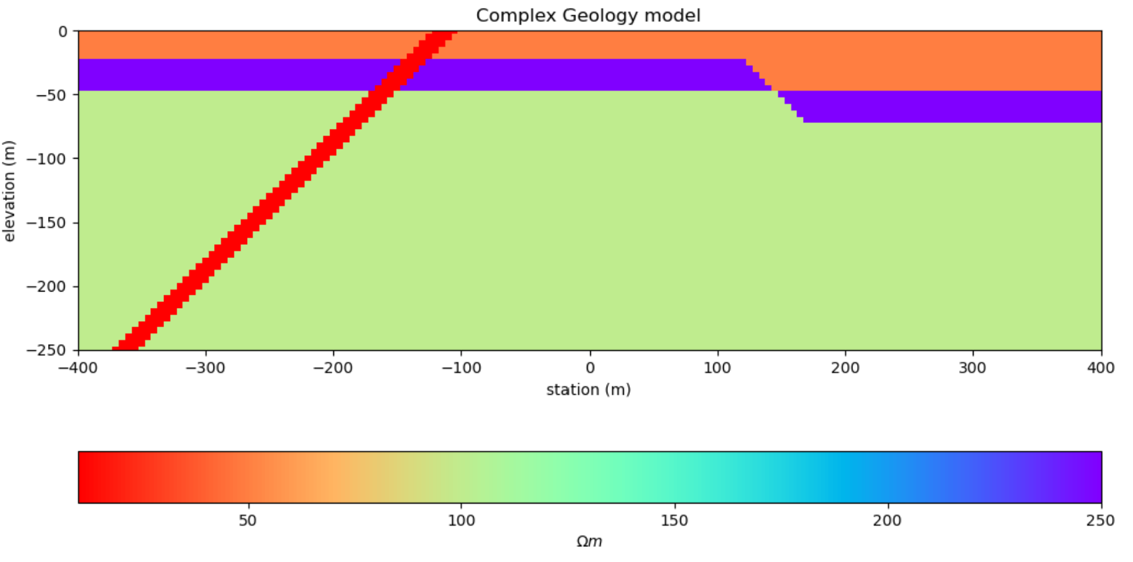
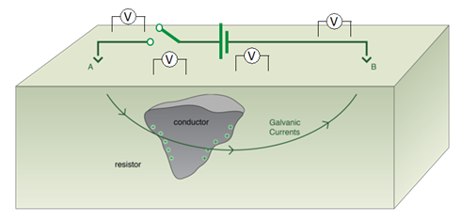
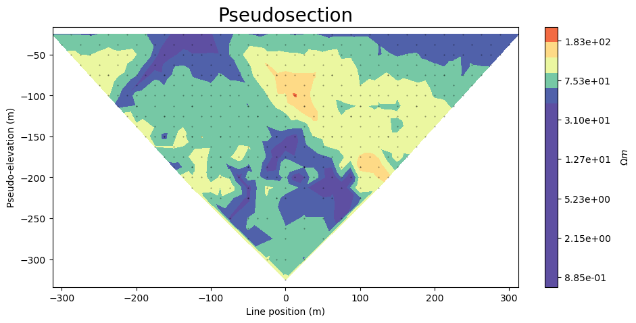
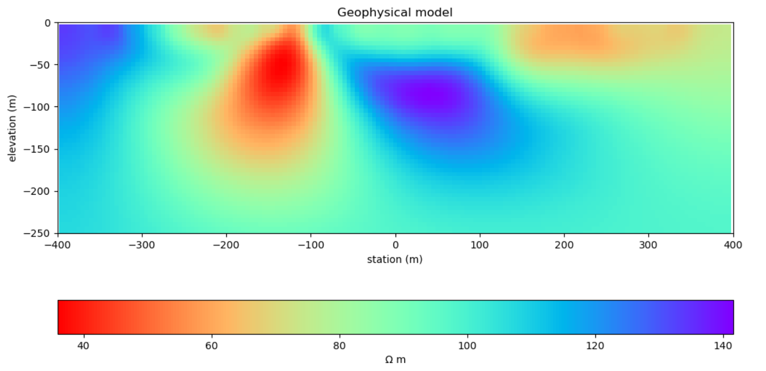
Motivation
Questions from geologists we hope to answer:
Structural dip information.
Where to expect to hit the mineralized zone.
Acquisition
Geology
Data
Geophysical Model
Notes:
As a geophysicist, we have, most commonly geologists, who come to us with some geology setting they would like to investigate. We then collect data, and get, hopefully, a nice inversion model.
With this we need to communicate questions such as what is the dip, what depth to unconformity. Or even volume estimates in monitoring leeching.

Slide 3
Motivation
Geology
Geophysical Model
Unconstrained geophysical model lacks definition.
Dip of intrusive dyke ambiguous.
Notes:
With this we need to communicate questions such as what is the dip, what depth to unconformity. Or even volume estimates in monitoring leeching.

Slide 4
Motivation
Can we improve the recovered model by using segmentation to enforce structure?
Without prior structural information, is there an automated way to interpret structure via segmentation?
Notes:
With this we need to communicate questions such as what is the dip, what depth to unconformity. Or even volume estimates in monitoring leeching.

Slide 5
Outline
Image segmentation
Variational models for segmentation
Applications
Notes:
Provides a way to favor orientational direction of underlying geological structures in the regularization
L2 smooth inversions
Example: typically, 1) we take measurements, typically collected in a grid, over an area of interest
2) data or measurements are passed into an “inversion” where our minimizer is our objective function here (equation).
3) we then find a most likely model that represents the subsurface.
4) choose a threshold to define the structure

Slide 6
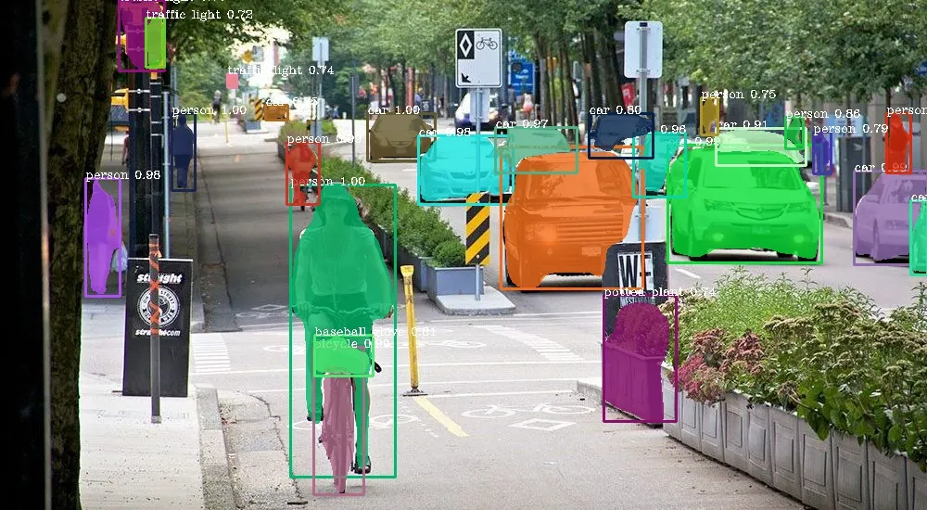
1.0 Image segmentation
Potter, 2021
Notes:
Image segmentation is the process of partitioning of digital images into various parts or regions

Slide 7
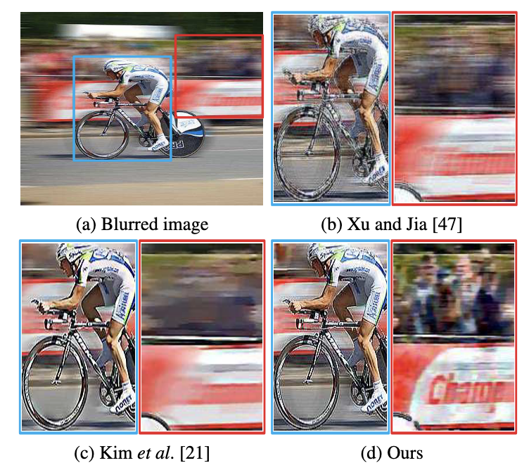
1.0 Image segmentation
Soft-Segmentation Guided Object Motion Deblurring
Pan et. al. , 2016
Notes:
With this we need to communicate questions such as what is the dip, what depth to unconformity. Or even volume estimates in monitoring leeching.

Slide 8
2.0 Variational models for Image segmentation

Slide 9
2.1 Mumford-Shah variational model
f : an image.
g : is the piecewise smooth approximation of the image.
Γ: is the set of discontinuities (edges).
λ: balances fidelity to the original image.
μ: penalizes the complexity (length) of the edge set.

Slide 10
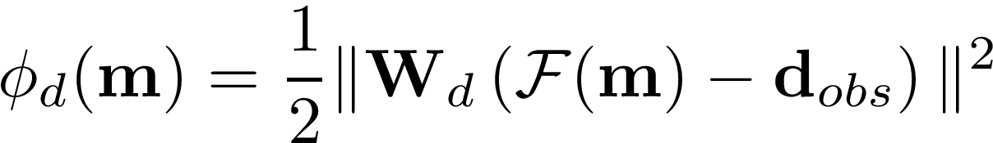
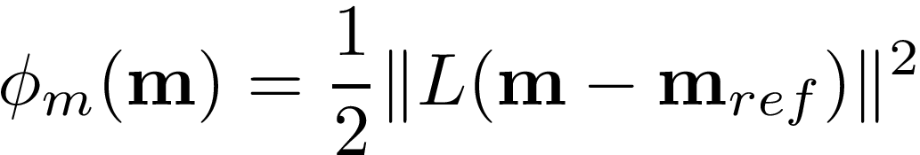
2.1 Mumford-Shah variational model
Segmentation:
Geophysical inversion objective function:
Data misfit
regularization

Slide 11
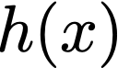
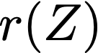
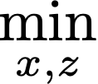

2.1 Mumford-Shah variational model
Solve using Alternating Direction Method of Multipliers (ADMM):
subject to the constraint:

Slide 12
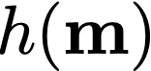
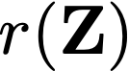
2.1 Mumford-Shah variational model
Piecewise Potts formulation
m = model
Z = auxiliary matrix of probabilities
F(m) = forward operator
d_{obs} = observed data
W_{d} = data weights
C = classes
𝜶 = Segmentation measure trade-off parameter
𝞰 = Segmentation regularization trade-off parameter
Notes:
\phi(\mathbf{m}, \mathbf{Z}) = \| \mathbf{W}_d (F(\mathbf{m}) - \mathbf{d}_{obs}) \|^2 + \alpha \sum_{i=1}^{N_{\text{cells}}} \sum_{j=1}^{N_{\text{classes}}} z_{ij} (\mathbf{m}_i^{k+1} - c_j)^2 + \eta \sum_{j=1}^{N_{\text{classes}}} |\nabla \mathbf{Z}_j|
\mathbf{m}^{k+1} = \min_{\mathbf{m}} \;\left\| \mathbf{W}_d (F(\mathbf{m}) - \mathbf{d}_{\text{obs}}) \right\|^2 + \gamma \sum_{i=1}^{N_{\text{cells}}} \sum_{j=1}^{N_{\text{classes}}} z_{ij} (\mathbf{m}_i - c_j)^2 + \frac{\delta}{\lambda} \left\| \mathbf{m} - \mathbf{s} + \mathbf{u} \right\|^2

Slide 13
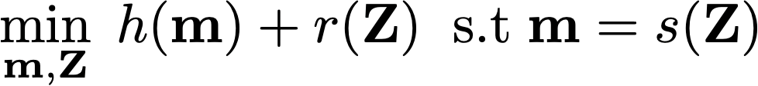
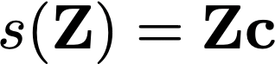
2.1 Mumford-Shah variational model
The ADMM setup is then:
Where s(Z) can be:
Hard-segmentation:
Soft-segmentation:
Notes:
\min_{\mathbf{m},\mathbf{Z} } \; h(\mathbf{m}) + r(\mathbf{Z}) \;\; \text{s.t} \mathbf{m} = s(\mathbf{Z})

Slide 14
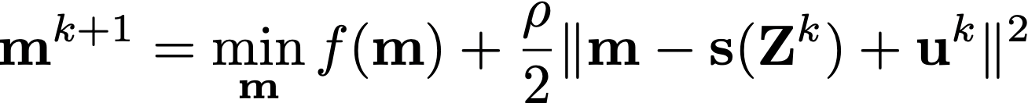
2.1 Mumford-Shah variational model
The ADMM algorithm consists of the following steps per iteration:
Take a step in the model space:
Take a step in the auxiliary space:
Update the dual variable:
Notes:
\mathbf{m}^{k+1} = \min_{\mathbf{m}} f(\mathbf{m}) + \frac{\rho}{2} \| \mathbf{m} - \mathbf{s}(\mathbf{Z}^k) + \mathbf{u}^k \|^2
\mathbf{Z}^{k+1} = \min_{\mathbf{Z}} g(\mathbf{Z}) + \frac{\rho}{2} \| \mathbf{m}^{k+1} - \mathbf{s}(\mathbf{Z}) + \mathbf{u}^k \|^2_2
\mathbf{u}^{k+1} = \mathbf{u}^k + \rho (\mathbf{m}^{k+1} - \mathbf{s}(\mathbf{Z}^{k+1}))

Slide 15
2.1 Mumford-Shah variational model
The full Lagrangian:
Coupling term
m = model
Z = auxiliary matrix of probabilities
F(m) = forward operator
d_{obs} = observed data
W_{d} = data weights
C = classes
u = Lagrangian multiplier
s = hard-segmentation model (or soft s=Zc)
𝞪 = segmentation trade-off
𝞰 = segmentation regularization trade-off
𝞺 = coupling factor
Notes:
\mathcal{L} (\mathbf{m}, \mathbf{Z}, \mathbf{u}) = \| \mathbf{W}_d (F(\mathbf{m}) - \mathbf{d}_{obs}) \|^2_2 + \alpha \sum_{i=1}^{N_{\text{cells}}} \sum_{j=1}^{N_{\text{classes}}} z_{ij} (m_i - c_j)^2 + \eta \sum_{j=1}^{N_{\text{classes}}} |\nabla \mathbf{Z}_j| + \rho \| \mathbf{m} - \mathbf{s} + \mathbf{u} \|^2_2

Slide 16
2.1 Mumford-Shah variational model
The ADMM steps for our problem are then:
Take a step in the model space:
Take a step in the auxiliary space:
Update the dual variable:
Notes:
\mathbf{m}^{k+1} = \| \mathbf{W}_d (F(\mathbf{m}) - \mathbf{d}_{obs}) \|^2_2 + \alpha \sum_{i=1}^{N_{\text{cells}}} \sum_{j=1}^{N_{\text{classes}}} z^k_{ij} (m_i - c_j)^2 + \rho \| \mathbf{m} - \mathbf{s}(\mathbf{Z}^k) + \mathbf{u}^k \|^2_2
\mathbf{Z}^{k+1} = \alpha \sum_{i=1}^{N_{\text{cells}}} \sum_{j=1}^{N_{\text{classes}}} z_{ij} (m^{k+1}_i - c_j)^2 + \eta \sum_{j=1}^{N_{\text{classes}}} |\nabla \mathbf{Z}_j| + \rho \| \mathbf{m}^{k+1} - \mathbf{s}(\mathbf{Z}) + \mathbf{u}^k \|^2_2

Slide 17
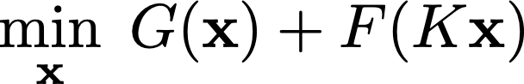
2.2 Primal dual solution
The step in the auxiliary space:
Minimization is of the form:
smooth
non-smooth
Notes:
\min_x \; G(x) + F(Kx)

Slide 18
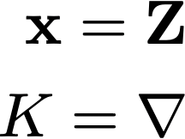
2.2 Primal dual solution
The step in the auxiliary space:
For our problem:
This has a unique primal-dual solution!
Notes:
\min_x \; G(x) + F(Kx)

Slide 19
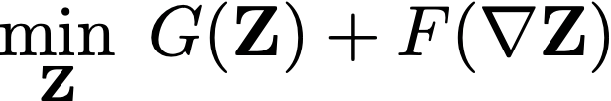
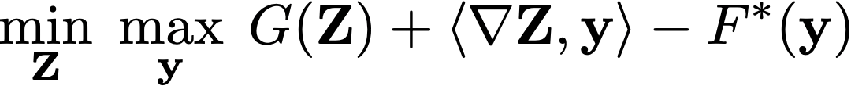
2.2 Primal dual solution
The step in the auxiliary space:
Using the Fenchel conjugate of the non-smooth term:
Reformulates to a saddle-point problem
Notes:
\min_{\mathbf{Z}} \; \max_{\mathbf{y}} \; G(\mathbf{Z}) + \langle \nabla \mathbf{Z}, \mathbf{y} \rangle - F^*(\mathbf{y})

Slide 20
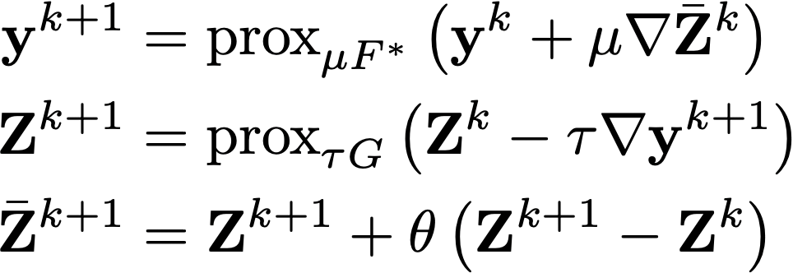
2.2 Primal dual solution
Chambolle-Pock to Iterate:
τ and μ are step sizes for the primal and dual updates, respectively,
θ is an extrapolation parameter,
is the extrapolated primal variable.
Notes:
\mathbf{y}^{k+1} &= \operatorname{prox}_{\mu F^*} \left( \mathbf{y}^k + \mu \nabla \bar{\mathbf{Z}}^k \right) \\
\mathbf{Z}^{k+1} &= \operatorname{prox}_{\tau G} \left( \mathbf{Z}^k - \tau \nabla \mathbf{y}^{k+1} \right) \\
\bar{\mathbf{Z}}^{k+1} &= \mathbf{Z}^{k+1} + \theta \left( \mathbf{Z}^{k+1} - \mathbf{Z}^k \right)

Slide 21
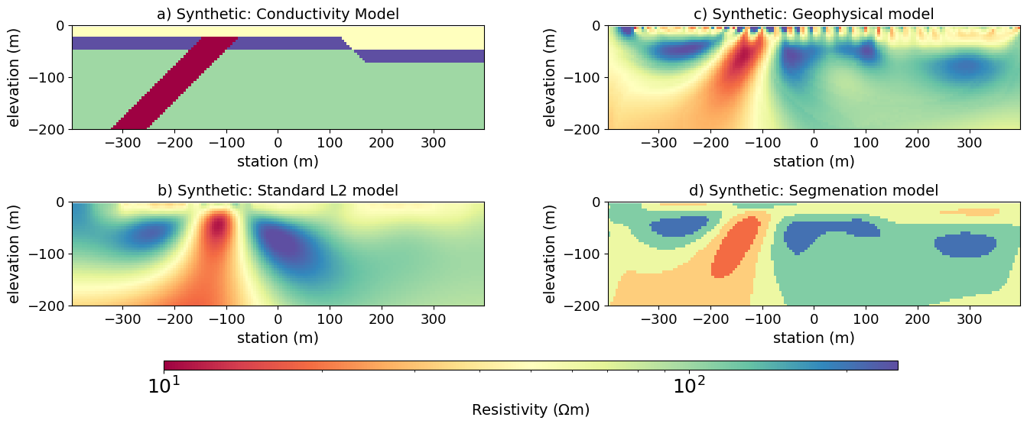
2.2 Primal dual solution
DC-resistivity inversion (hard-segmentation):

Slide 22
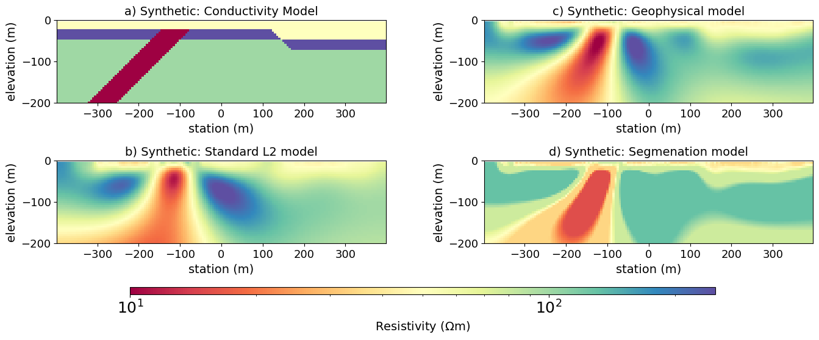
2.2 Primal dual solution
DC-resistivity inversion (soft-segmentation):

Slide 23
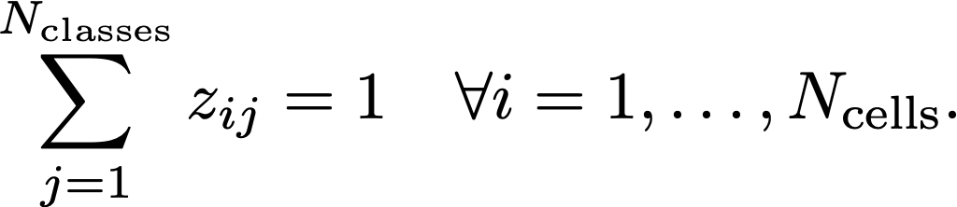
2.3 Optimal Transport
transport schedule
entropy term
subject to the constraint:
Has an efficient solution using Sinkhorn Iterations by adding Lagrange multipliers λ
Notes:
\mathbf{Z}^{k+1} = \min_{\mathbf{Z}} \;\alpha \sum_{i=1}^{N_{\text{cells}}} \sum_{j=1}^{N_{\text{classes}}} z_{ij} (m^{k+1}_i - c_j)^2 + \epsilon \sum_{i=1}^{N_{\text{cells}}} \sum_{j=1}^{N_{\text{classes}}} z_{ij}\log(z_{ij}) + \rho \| \mathbf{m}^{k+1} - \mathbf{s}(\mathbf{Z}) + \mathbf{u}^k \|^2_2

Slide 24
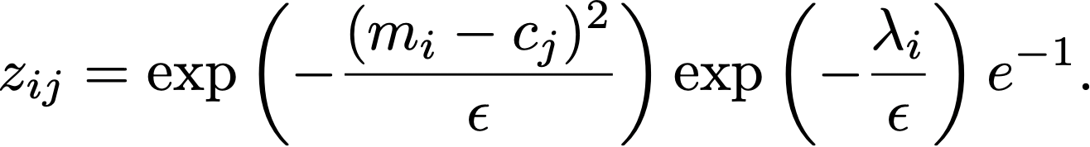
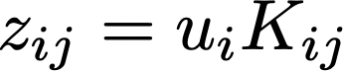
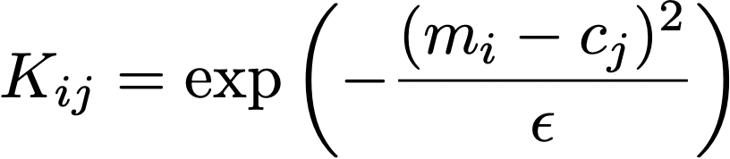
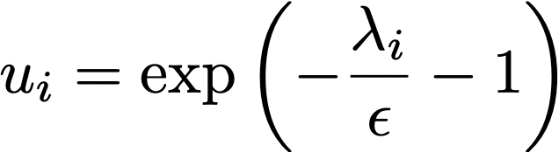
2.3 Optimal Transport
If we take the gradient and set to zero and solve Z, we get:
where:

Slide 25
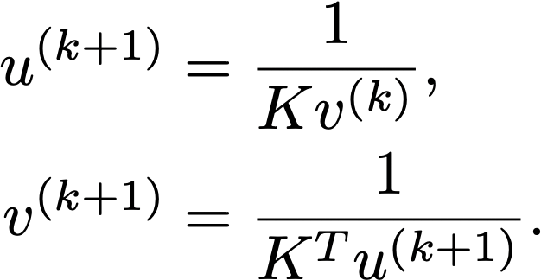
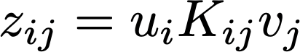
2.3 Optimal Transport
Introduce to two dual variables u and v and alternate update every iteration until convergence
At convergence, the optimal transport plan Z is recovered by:
Notes:
Iterations only involve multiplications and can be made efficient offloading to the GPU or packages like Numba.
u^{(k+1)} &= \frac{1}{K v^{(k)}}, \\
v^{(k+1)} &= \frac{1}{K^T u^{(k+1)}}.
K_{ij} = \exp\left( -\frac{(m_i - c_j)^2}{\epsilon} \right)

Slide 26
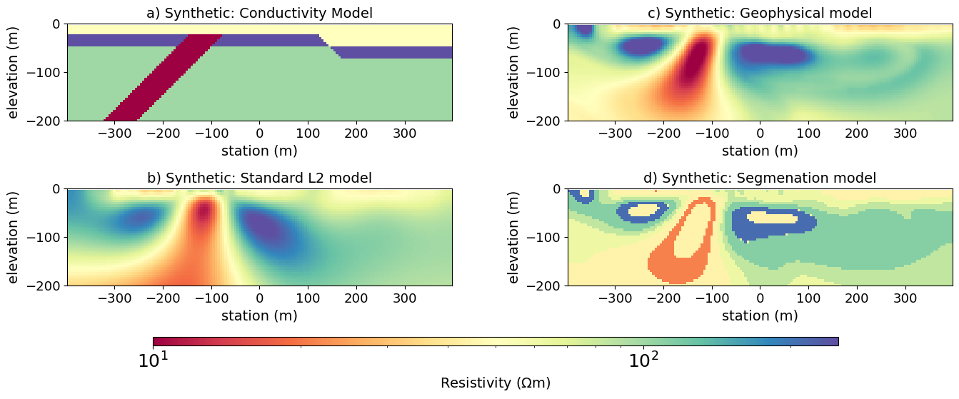
2.3 Optimal Transport
DC-resistivity inversion (hard-segmentation):

Slide 27
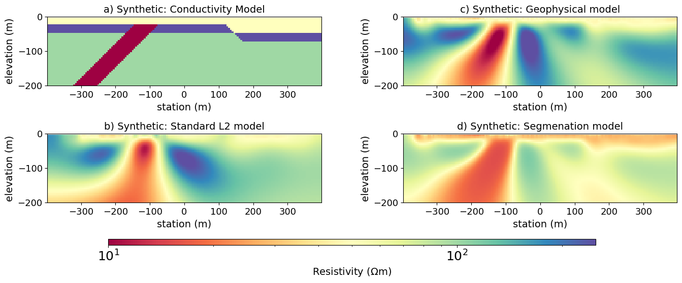
2.3 Optimal Transport
DC-resistivity inversion (soft-segmentation):

Slide 28
3.0 Applications

Slide 29
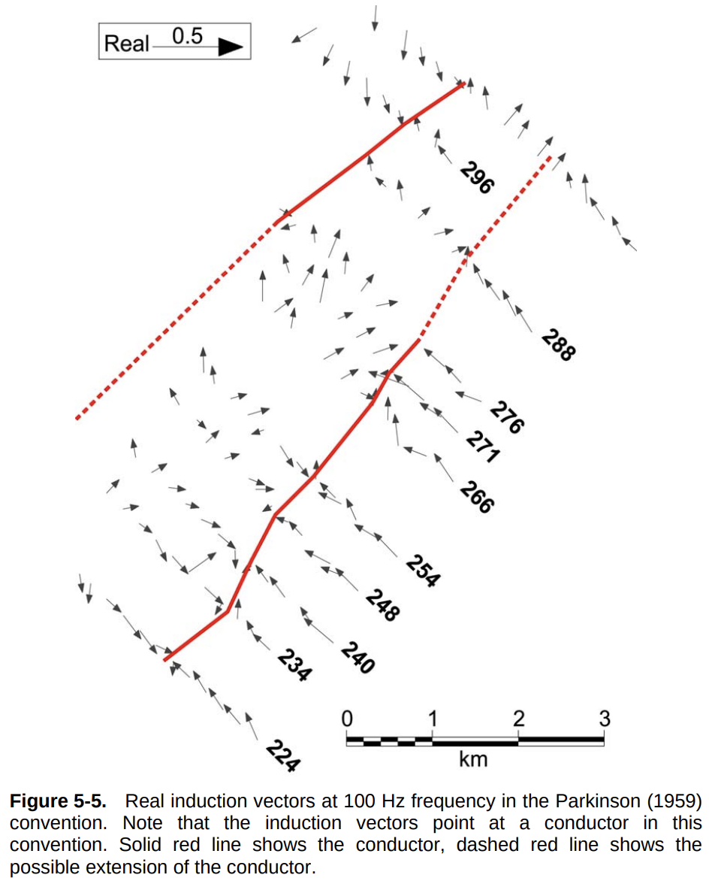
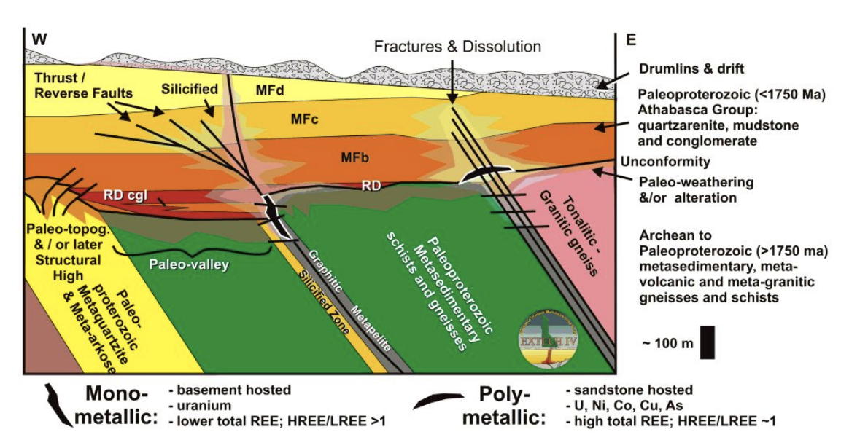
3.1 Field Example - McArthur River
304
(Jefferson et al., 2007)
(Tuncer, 2007)
Notes:
40-65 degree dipping to SE (Shannon Dee, 2017)

Slide 30
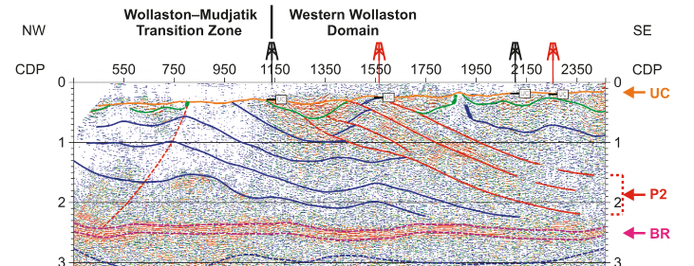
2.3 Applied Example - McArthur River
3.1 Field Example - McArthur River
Hajnal, 2017

Slide 31
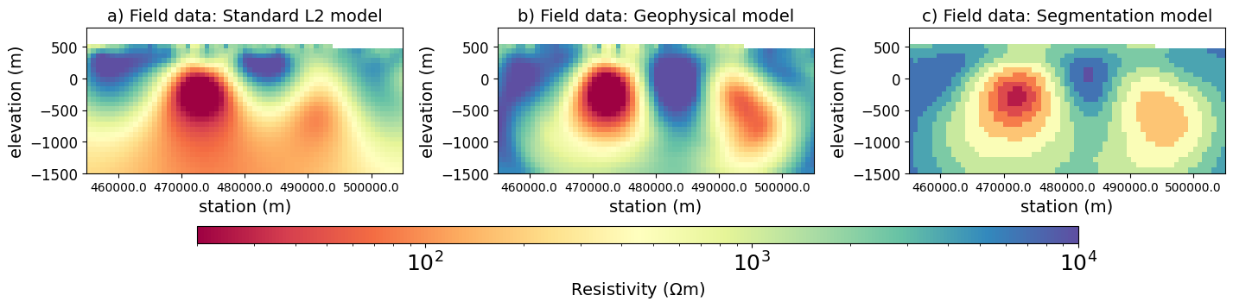
2.6 Field Example - McArthur River Revisited
3.1 Field Example - McArthur River
MT field data:
Primal dual solution - Hard segmentation

Slide 32
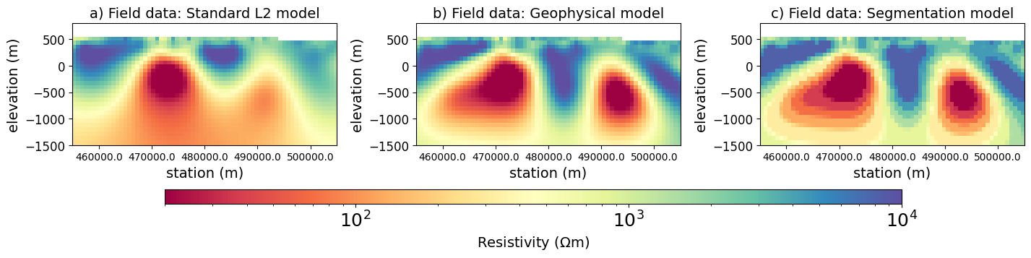
2.6 Field Example - McArthur River Revisited
3.1 Field Example - McArthur River
MT field data:
Primal dual solution - Soft segmentation

Slide 33
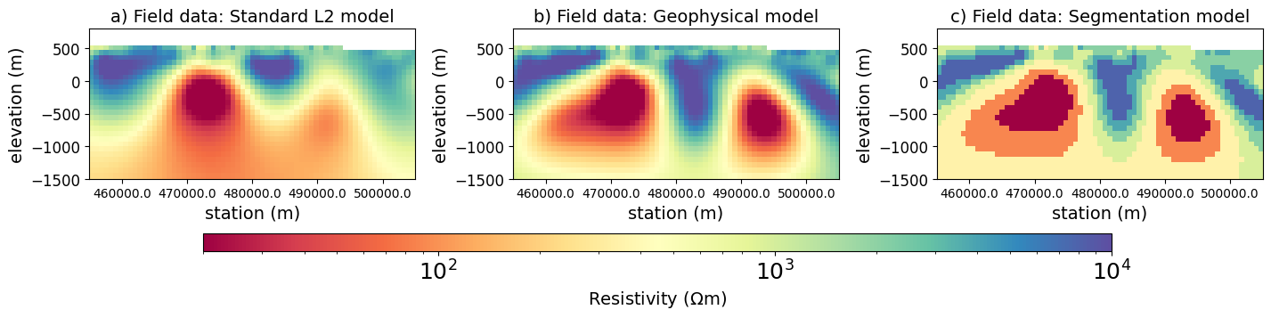
2.6 Field Example - McArthur River Revisited
3.1 Field Example - McArthur River
MT field data:
Optimal Transport solution - Hard segmentation

Slide 34
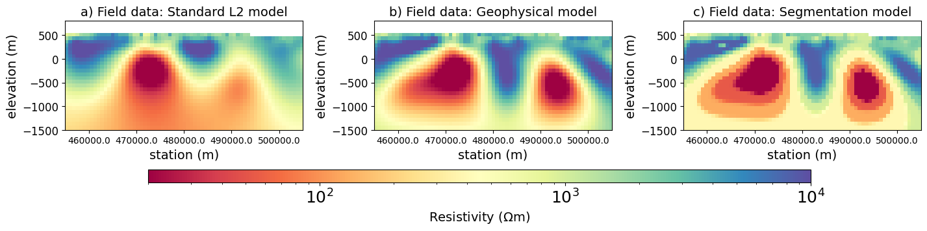

2.6 Field Example - McArthur River Revisited
3.1 Field Example - McArthur River
MT field data:
Optimal Transport solution - Soft segmentation

Slide 35
Motivation
Can we improve the recovered model by using segmentation to enforce structure?
Without prior structural information, is there an automated way to interpret structural information via segmentation?
Notes:
With this we need to communicate questions such as what is the dip, what depth to unconformity. Or even volume estimates in monitoring leeching.

Slide 36
Conclusion
Image segmentation methods can improve the structural detail in geophysical models.
We can use segmentation to interpret structure.

Slide 37










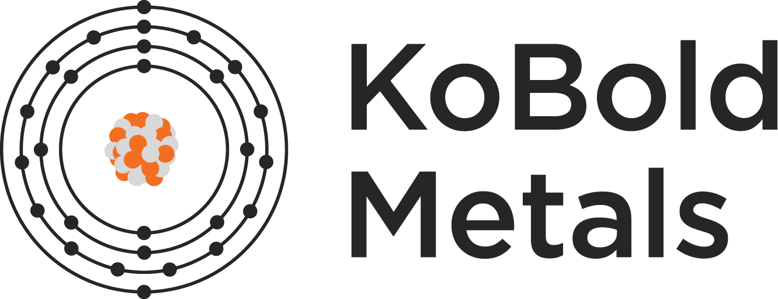


Thank you!
Primal-Dual
Optimal Transport
simpeg.xyz
jkutt@eoas.ubc.ca
UBC GIF sponsors:

